Slide 1
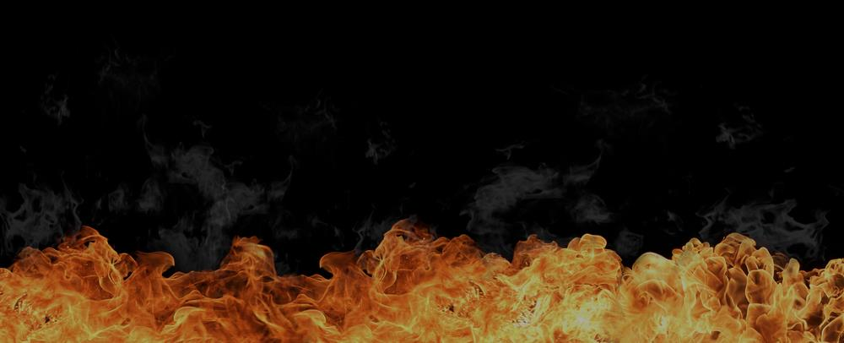


If an Almighty God decides, for whatever reason, to put you in Hell, you won’t be able to stop Him. So, you should...
fear him which is able to destroy both soul and body in hell.
Matthew 10:28
2 quick questions if I may, please…
Q1:
Can you explain to me your need for righteousness?
It’s a tough question, I know. Stay with me here,
you’re about to learn the correct answer: God’s answer!
If you were to live the rest of your life as a serial killer
could that possibly hurt your chances of going to Heaven?
Q2:

Slide 2
Many will beg and plead with God on Judgment Day. Jesus said:
Many will say to me in that day,
Lord, Lord, have we not … in thy name
done many wonderful works?
Matthew 7:22
I loved my fellow man
“I was pretty good”
I taught Sunday School
I gave lots to charity
My dad was a pastor
I was baptized
I followed the golden rule
“I never killed anyone”
All religions are the same
I kept the 10 commandments
I built churches, houses and hospitals
I adopted poor children
“I believed in Jesus”
I fought for equality and justice
I asked you into my heart
I did everything my religion told me to
“I went to church” … blah, blah, blah
I was a deacon
I am an atheist
How exactly will Jesus answer every time?

Slide 3
Jesus will answer:
I never knew you: depart from me,
ye that work iniquity…into everlasting fire
Matthew 7:23
+Matthew 25:41
He says that they “work iniquity”. Why? Because…
Every work that they’ve ever done is:
iniquity...
sin!

Slide 4

The Bible says: their works are works of iniquity
... all our righteousnesses are as filthy rags,
... there is none that doeth good, no, not one.
Isaiah 59:6, Isaiah 64:6, Psalms 53:3, Romans 3:12
All your works, not just your sins, are filthy to God.

Slide 5

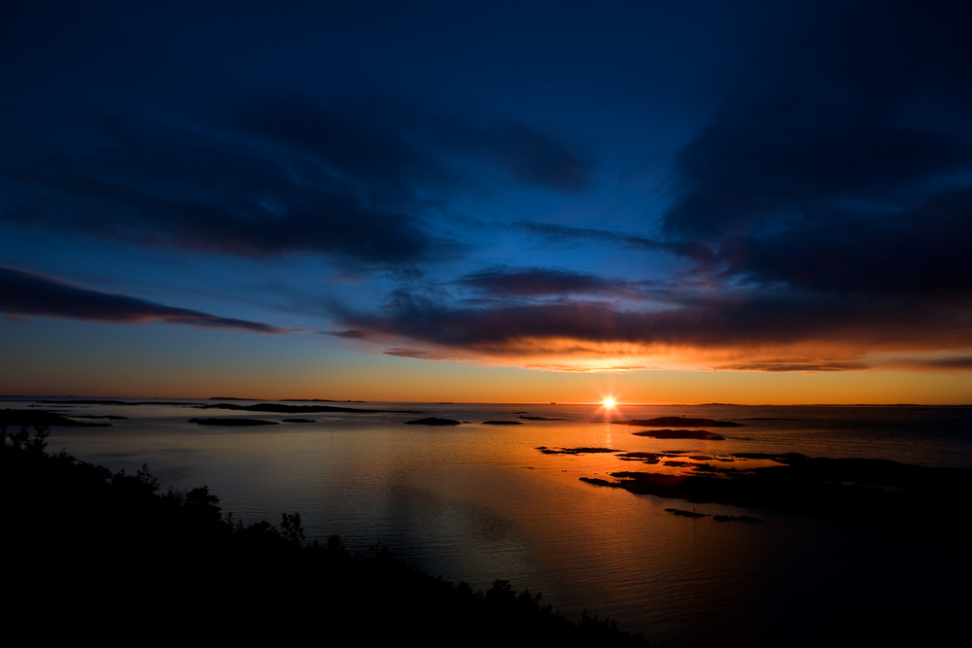

They believed in God. But they also thought they had to do:
... many wonderful works.
Matthew 7:22
They never stopped trusting in their works!
They believed…
Be Good
Be Bad
HEAVEN
HELL
go to
go to
Lie
That keeps people out of Heaven. So, if...
thou hast trusted in thy works ...
thou shalt also be taken [and] cast into hell;
Jeremiah 48:7
Luke 12:5

Slide 6
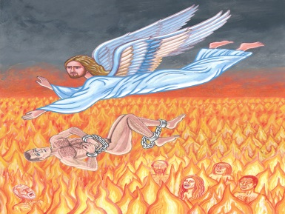
The Book of Revelation says:
there shall in no wise enter into [Heaven]
any thing that … maketh a .
Lie
Revelation 21:27
Lie
And you certainly can make a . So...
That’s you!
Lie
Unless it’s completely impossible for you to .
All liars
, shall have their part in the
lake which burneth with fire and brimstone
Revelation 21:8

Slide 7







No matter how hard we try, the Bible says we...
… cannot cease from sin;
2 Peter 2:14
Yet many are trying desperately to please God
with their works !
e
=mc²
The Bible says …
They have a zeal of God,
But not … knowledge
Romans 10:2

Slide 8
For they being ignorant of
and going about to establish
have not submitted themselves unto
Romans 10:3
God’s righteousness
their own righteousness
the righteousness of God
Remember when I asked you about …
“your need for righteousness”?
Unless you answered “I need God’s righteousness ”, you are...
ignorant of God’s Righteousness.

Slide 9

And remember when I asked you about being a…
serial killer ?
If you answered, “yes, it could hurt my chances”,
or even, “I’m not sure”, then you are…
working to establish your own righteousness

Slide 10
Those who are:
ignorant of God’s Righteousness
✓
... and ...
✓
working to establish
their own righteousness
have not submitted themselves unto
Romans 10:3
the righteousness of God
This is why many think they’re saved, but they’re not.

Slide 11

Liar
There is only one way to stop being a .
There is only one way to “cease from sin”.
You need
God’s righteousness
not
your own righteousness
All the world’s religions only teach people how to...
establish their own righteousness
Romans 10:3
They all teach… some belief system
works!
e
=mc²

Slide 12
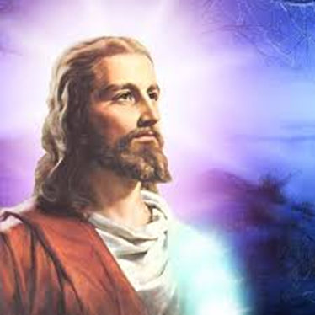
Since Jesus is... God…manifest in the flesh
And it is… impossible for God to lie...
Hebrews 6:18
1 Timothy 3:16
Jesus has...
The Impossibility of Sin
Jesus is...
God’s Righteousness
Since it was completely impossible for Jesus to sin...
[God] hath made him…who knew no sin ...
2 Corinthians 5:21

Slide 13



For he hath made him .... to be sin for us,
Why? So … that we might be made
the righteousness of God in him.
2 Corinthians 5:21
God’s Righteousness
gives us…
Righteousness
Impossibility of sin!
impossibility of sin!
No one but Jesus can give you the

Slide 14


When the righteousness of God is given, it is placed:
Luke 17:21
within you ... that the spirit may be saved.
1 Corinthians 5:5
Until the resurrection, the impossibility of sin ...
is not given to the flesh…
…but only to the
spirit.
When a person is given the impossibility of sin :
It is the spirit that...cannot sin
but...the flesh profiteth nothing
John 6:63
1 John 3:9
Mark 14:38

Slide 15


… of this ignorance [ignorance of God’s righteousness]
God …now commandeth all men ...
to repent :
Acts 17:30
To Repent does not mean to change your works:
by starting to go to church and trying to live a
cleaner life. It means to change your thinking.
2 Timothy 2:25
Jeremiah 18:7-10
You need to Repent : to change your mind
From trusting at all in
To trusting only in
your righteousness
God’s righteousness
where your works
where only
Jesus
matter
- and you
matters
- and HE
can sin
cannot sin

Slide 16



If you don’t Repent of your works (not your sins)…you get no grace!
The Bible says...
if by grace, then is it no more of works:
But if [by] works, then is it no more grace
Romans 11:6
Jesus was saved by
We must be saved by
Works
ALONE
Grace
ALONE
without a drop of
without a drop of
Grace
Works
If you believe that you must maintain good works…
Christ is become of no effect unto you.
Christ shall profit you nothing …
Galatians 5:4,2
Notes:
Not one drop of grace could have been included in Jesus’ salvation – He had to be saved completely by works.
Not one drop of works could have been included in your salvation – you had to be saved completely by grace.

Slide 17


In the Lake of Fire, you will...
Ignite in unimaginable pain.
Even your tongue will be on fire.
Luke 16:24
James 3:6
Be constantly terrified,
Psalm 73:19
Jude 1:13
Isaiah 60:2
Exodus 10:21-22
in a “gross” darkness that you’ll feel.
Be tortured relentlessly,
Revelation 9:2-10
Joel 2:3-11
Luke 16:23-24
by crazed, angry, merciless creatures.
Revelation 14:11
Isaiah 57:20-21
Isaiah 48:22
Job 15:20
Revelation 20:10
Never have one moment of rest or relief.
And melt – not burn up, but slowly melt
Psalm 112:10
Job 25:6
Psalms 22:6
– down to your very core : a worm.

Slide 18
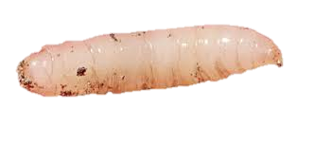
Finally, you will be…
A maggot
Mark 9:44
Isaiah 66:24
Exodus 16:20
trapped in a brutally cruel Lake of Fire,
to spend eternity…
Mark 14:21
Job 3:3
… wishing you had never been born.
Your greatest regret... will be this moment right now.
The Bible says... It is a fearful thing to fall into the hands of the living God.
Hebrews 10:31

Slide 19

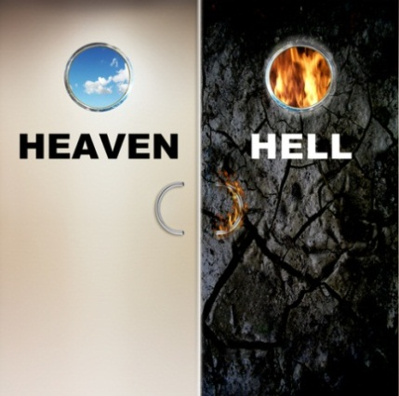
So, the final question is…
Or will you die trusting in...
your own
righteousness?
Do you want…
God’s
Righteousness?
If you want God’s righteousness, its very simple.
The Bible says...…whosoever shall call upon
the name of the Lord shall be saved.
Romans 10:13

Slide 20
You just need to sincerely pray…
Dear Lord,
I REPENT OF BELIEVING IN WORKS,
I must be saved by grace, without works.
I BELIEVE JESUS IS GOD,
The One True Almighty God.
I BELIEVE ONLY JESUS MATTERS,
Jesus died for me, and rose again.
I SUBMIT TO GOD’S RIGHTEOUSNESS,
so I will have, the impossibility of sin.
Amen.
Would you like to pray that right now?

Slide 21
If you prayed that and you meant it…
You have the IMPOSSIBILITY OF SIN
Your SPIRIT is 100% perfect and cannot sin
No matter what your FLESH does
You have GOD’S RIGHTEOUSNESS
You can NEVER lose it
Even if YOU become a serial killer
Because Jesus was NOT a serial killer!
and ONLY JESUS matters

Slide 22
Years from now, someone may ask,
“are you going to go to Heaven when you die”?
Absolutely!!
Now you can answer…
“How can you say that?” they may ask.
You can answer…
Because I have God’s Righteousness
It is impossible for me to go to Hell!

Slide 23

THE END
Begin the presentation again
on the front of the next card.

Slide 24
www.LibertyHavenBC.com/Lordswatch

Slide 25
User Guide: How dare we judge a person as saved or lost?
Judge not according to the appearance, but
judge righteous judgment.
John 7:24
1 Kings 10:1
We PROVE it with hard questions, about righteousness!
Matthew 12:33
…the tree is known by his fruit…the fruit of our lips
Hebrews 13:15
We check their heart (words), not their works (appearance).
When asked Q1 about their “need for righteousness”, were they,
ignorant of
God’s Righteousness
?
No=“I need God’s Righteousness”
Yes=any other answer
When asked Q2 about being a serial killer, do they believe in,
going about to establish
their own righteousness
?
No=“No”
Yes=any other answer
If both answers are ‘yes’, Romans 10:2-3 says,
they have not submitted to
the righteousness of God
This LOST person is still trusting in their works.

Slide 26
They profess that they know God;
but in works they deny him…
Titus 1:16
…They don’t deny God by ‘doing’, they deny God by “being”. They don’t ‘do’ abominable things, they are “abominable”. They don’t disobey, they are “disobedient”. They are “unto every good work reprobate”! Because they are “in works” instead of “in Christ”.
…if we deny him, he also will deny us:
2 Timothy 2:12
God is going to deny anyone that is still
trusting even a tiny bit - in their works.
because thou hast trusted in thy works …thou shalt also be taken
Jeremiah 48:7
Humans can’t stop sinning to get to Heaven.
Humans must stop working to get to Heaven.

